Slide 1
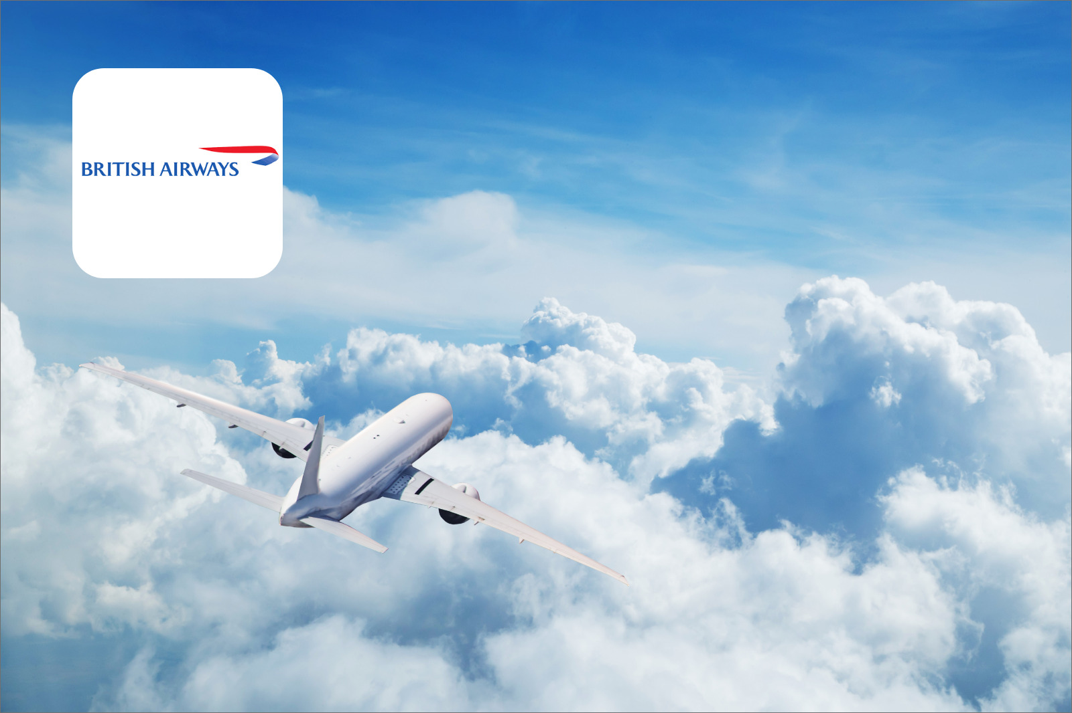
Reviews Analysis
By: Dhanashree Nangre

Slide 2
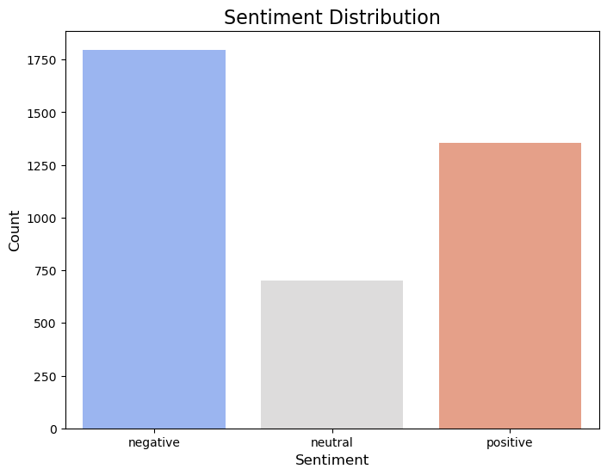
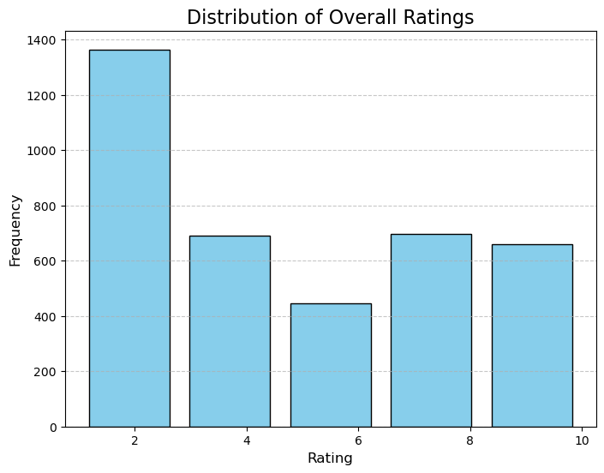
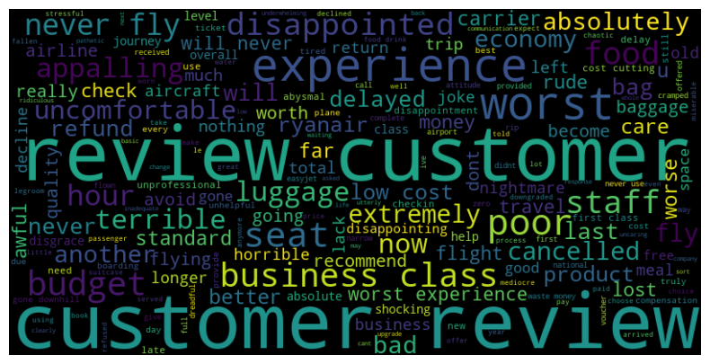
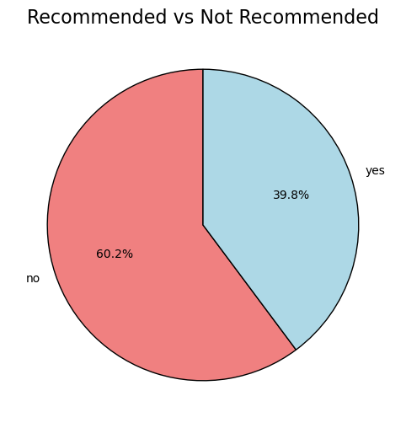
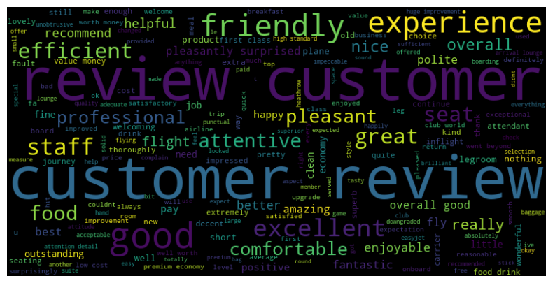
Word cloud of negative reviews:
Topic modeling results for Nnegative reviews:
1. never', 'fly', 'class', 'business', 'poor'
2. experience', 'worst', 'food', 'seat', 'appalling'
3, 'review', 'disappointed', 'terrible', 'cancelled'
Topic modeling results for positive reviews:
1. 'customer', 'review', 'excellent', 'enjoyable', 'seat.
2. 'good', 'friendly', 'staff', 'great', 'efficient'
3. 'experience', 'good', 'flight', 'food','recommend'
Word cloud of positive reviews:

